Slide 1
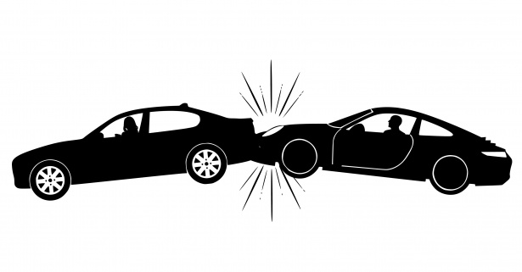
PREDICTIVE MODEL FOR CAR INSURANCE CLAIM

Slide 2
PROBLEM STATEMENT
Develop a predictive model that assesses the claim probability for car insurance policies.

Slide 3
OBJECTIVE
Predictive Model Building
Understanding Factors
Risk Assessment
Premium Determination

Slide 4
Features
NUMERICAL FEATURES | CATEGORICAL FEATURES
policy_tenure,age_of_car,age_of_policyholder, population_density,make,airbags,displacement, Cylinder,gear_box,turning_radius,length,width, height, gross_weight,ncap_rating, | policy_id, area_cluster, segment, model, fuel_type, max_torque, max_power, engine_type, is_esc, is_adjustable_steering, is_tpms, is_parking_sensors, is_parking_camera, rear_brakes_type, transmission_type, steering_type, is_front_fog_lights, is_rear_window_wiper, is_rear_window_washer, is_rear_window_defogger, is_brake_assist, is_power_door_locks, is_central_locking, is_power_steering, is_driver_seat_height_adjustable, is_day_night_rear_view_mirror, is_ecw, is_speed_alert

Slide 5
Approach
Data Cleaning(null value treatment,duplicates,missing value treatment,outlier treatment)
Column Transformation(column type casting,column manipulation)
Univariate Analysis(distplot,boxplot,countplot)
Bivariate Analysis(distplot hue=target,bar plot,stacked bar,box plot hue=target)
Multivariate Analysis(heatmap)
Model Building and Prediction

Slide 6
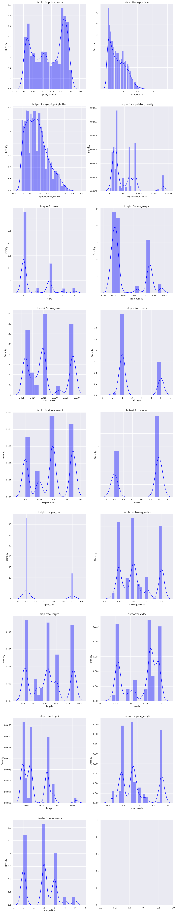
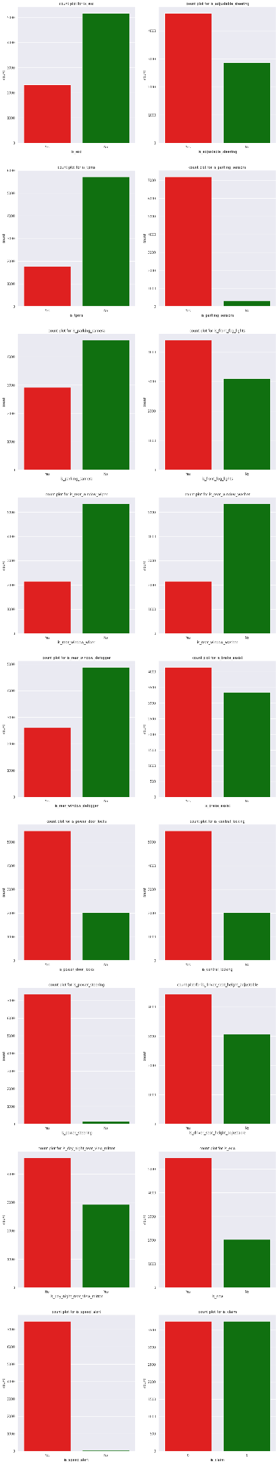
UNIVARIATE ANALYSIS
Inference:
All the numerical columns are skewed
Some categorical columns are having high yes to no ratio

Slide 7
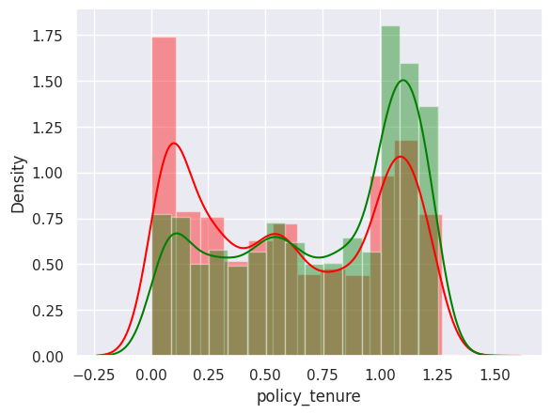
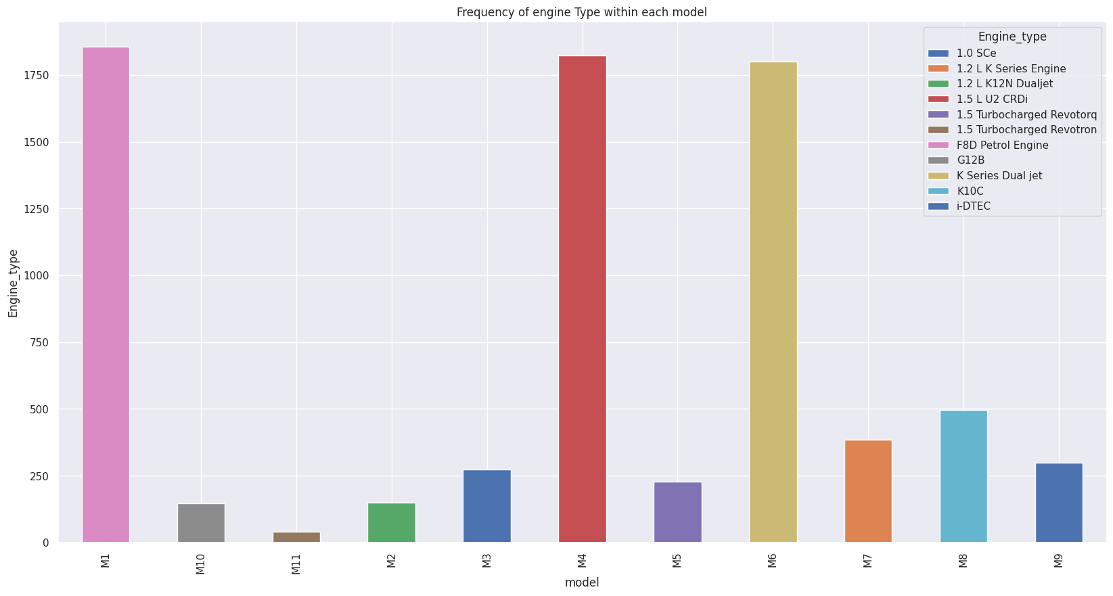
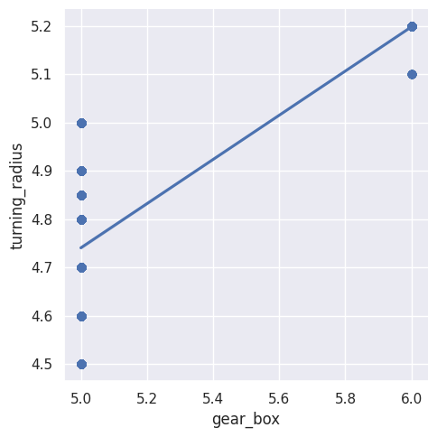
Bivariate Analysis

Slide 8
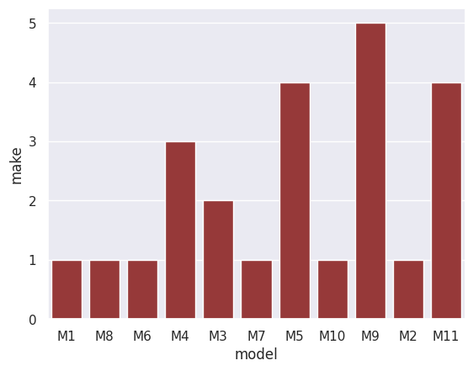
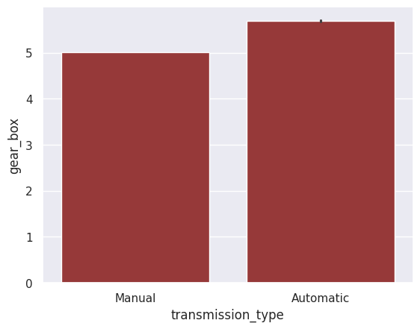

Slide 9
Inferences
Policy tenure has more influence on target column
Area _cluster is formed according to the population density
All the cars of same model have same engine type
Cars with manual transmission type have 5 gears and cars with automatic transmission has 6 gears
M1,M8,M10,M2,M6,M7 are made by manufacturer 1 ,M5,M11 are made by manufacturer 4 remaining manufacturers have only one model for each
Turning radius is more for 6 geared car than 5 geared car
Cars of same model have same max_power, max_torque, displacement, airbags,cylinder, gear_box, turning_radius, gross_weight and height

Slide 10
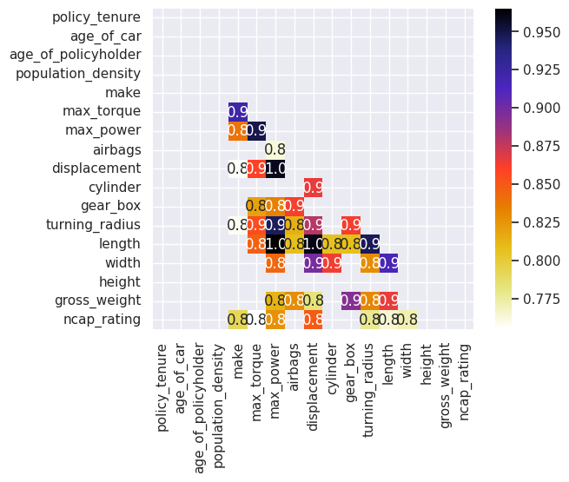
Multivariate Analysis
Inference:
max_power, max_torque, displacement, airbags, cylinder, gear_box, turning_radius, gross_weight ,ncap rating and height are highly correlated to each other

Slide 11
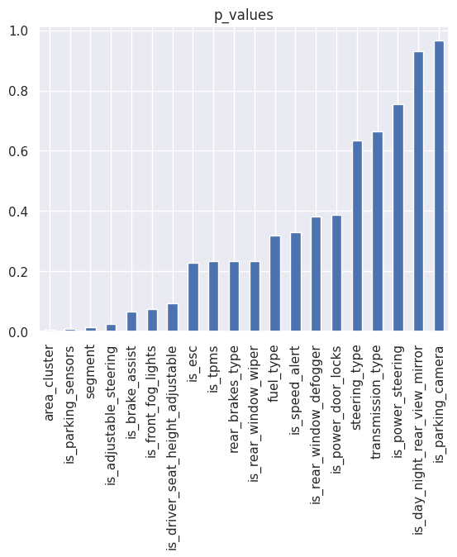
Chi2 test
Inferences:
Area_cluster,is_parking_sensors and segment are most important categorical features for the target class

Slide 12
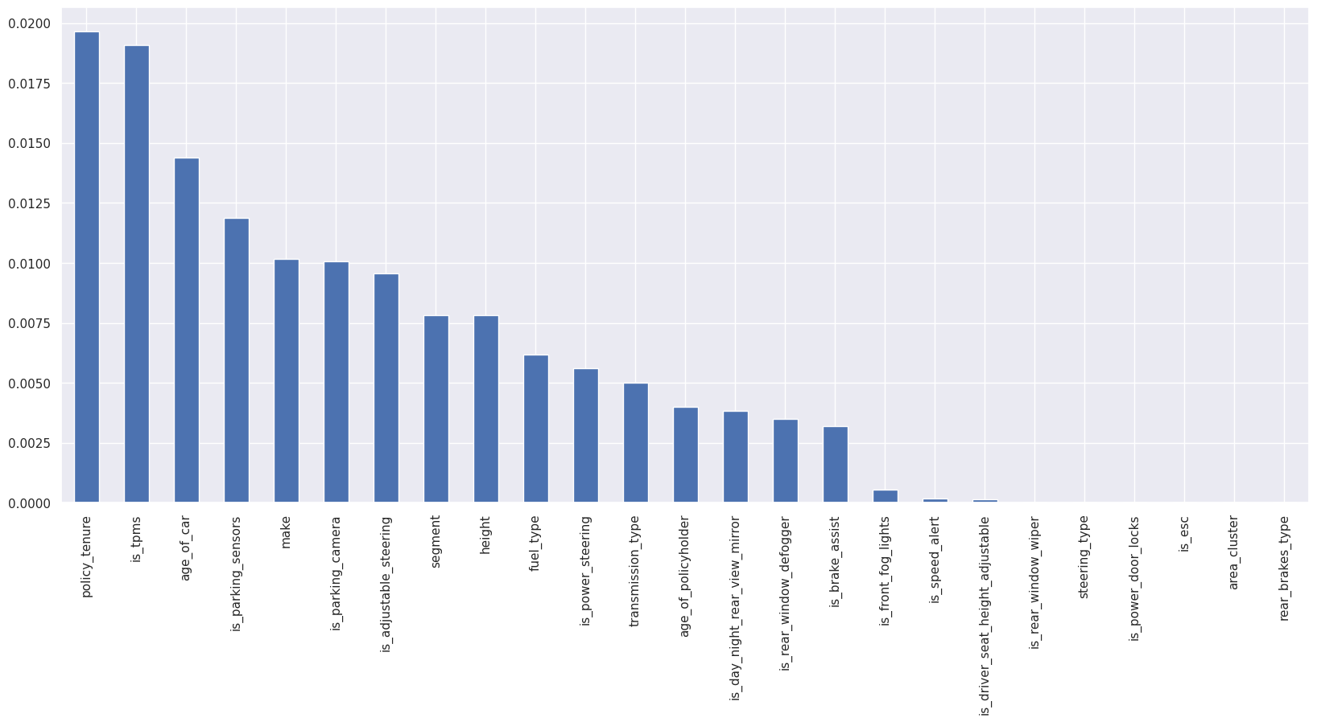
Mutual Information
Inferences:
No features have much influence in target column.In the given features policy_tenure has more influence on target column that is also only almost 3%

Slide 13
Conclusion
There are so many correlated input features
Most of the features have no influence on insurance claim
Among the given features policy_tenure is the most important feature

